Slide 1




Slide 2
Project Overview and Purpose
Determine the most effective and acceptable course of action to improve access to train stations in southeast Morris County for all users of all ages and abilities, including transit dependent populations.

Slide 3
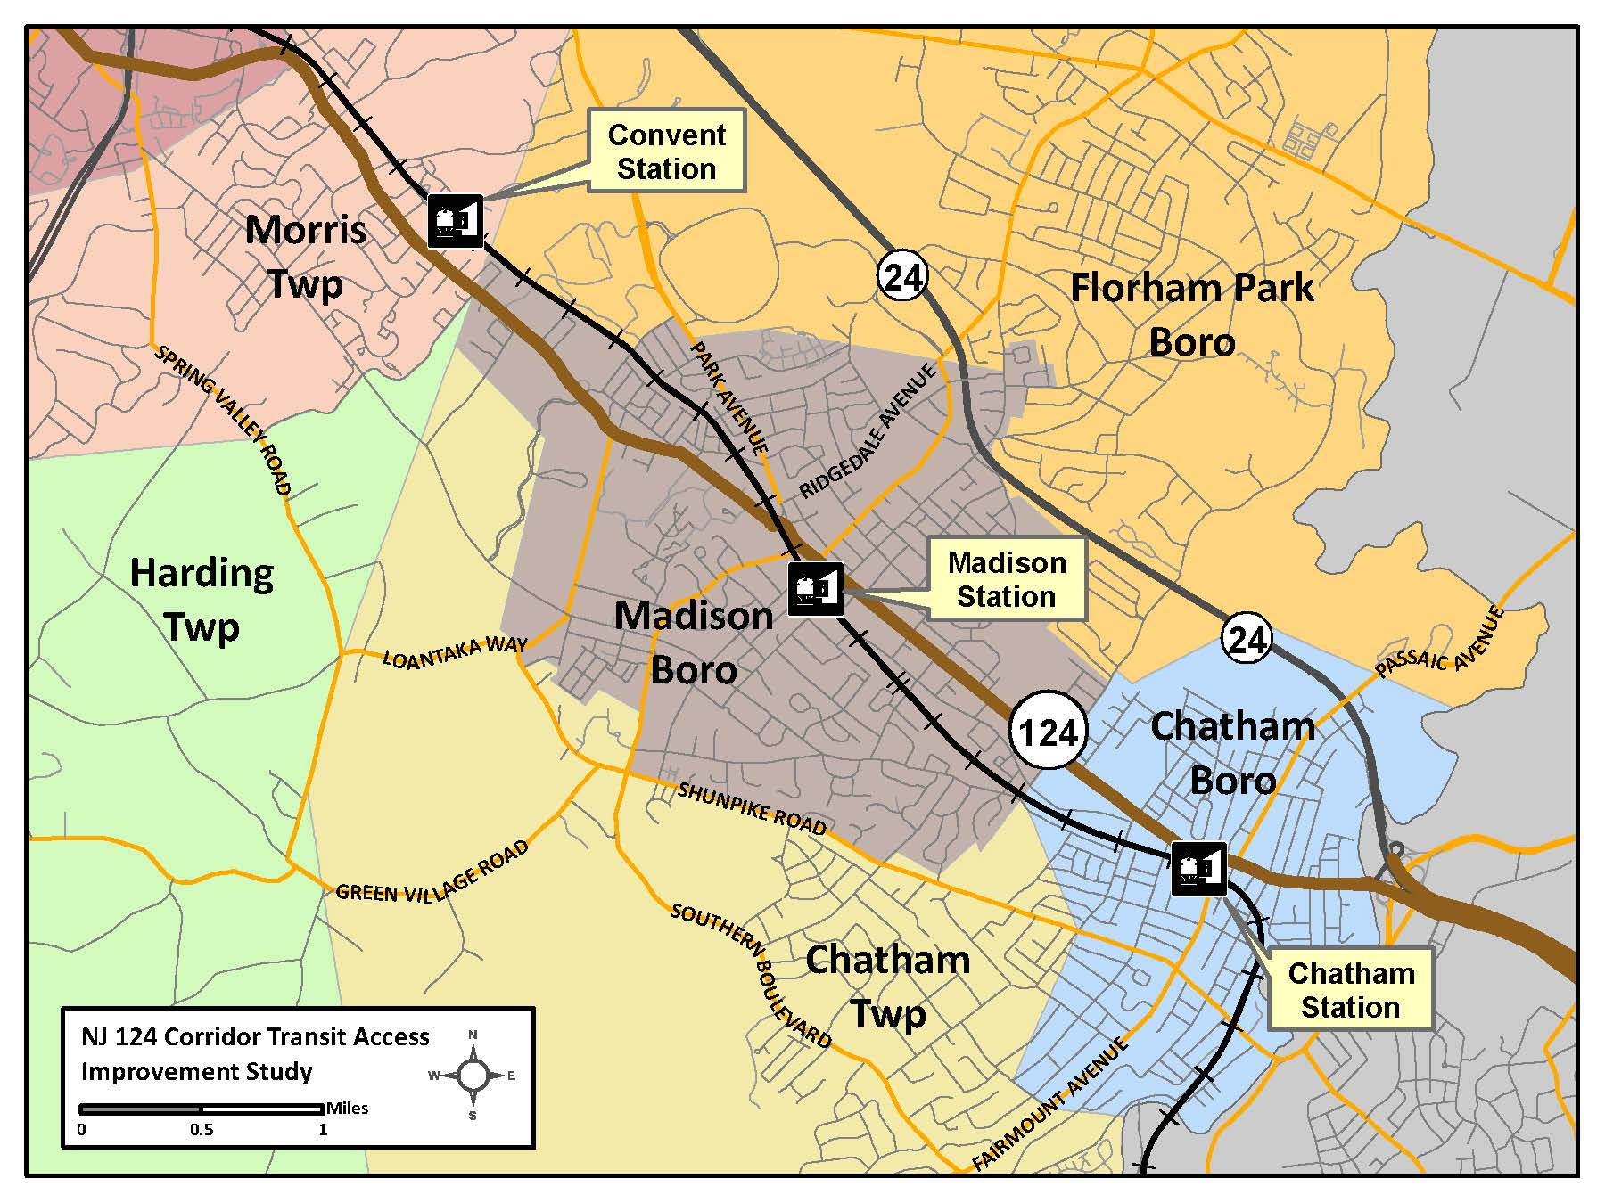
Study Area

Slide 4
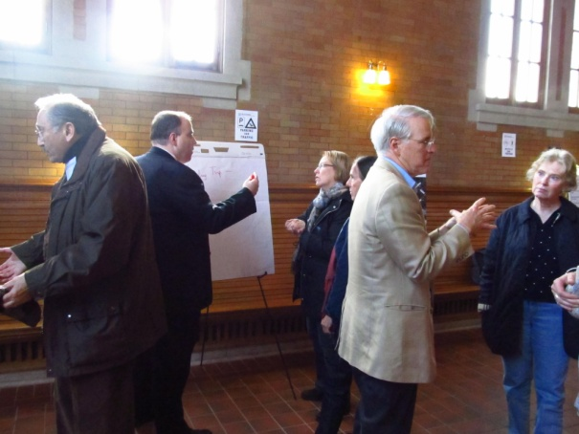
Project Progress
Task 1: Project Management
  Monthly Progress
  Project Management Plan
Task 2: Literature Search and Review
  Collected and Summarized Data from Previous Studies
  Task 2 Literature Search and Review Technical Memorandum
Task 3: Municipal Interaction and Public Input
  Conducted and documented TAC Meeting #1
  Stakeholder Interviews
  Public Open House
  Web-based Survey
  NJ TRANSIT ScoreCard Survey
  Project presentation to the Morris County Transportation Board
  Multiple Task 3 Technical Memoranda

Slide 5
Project Progress
Task 4: Zoning Analysis around Rail Stations
  Task 4 Zoning and Transit Oriented Development Technical Memorandum
Task 5: Current and Future Station Access Demand Analysis
  Task 5 Current and Future Station Demand Technical Memorandum
Task 6: Access by All Modes Evaluation
  Field Data Collection
  Parking Utilization Study
  Task 6 Parking Utilization Study Technical Memorandum
  Task 6 Existing and Future Conditions Technical Memorandum
Task 7: Access by All Modes Evaluation
  Task 7 Objectives and Recommendations Memorandum

Slide 6
Overview of Recommendations
Two Improvement Scenarios Were Assessed: with and without Transit-Oriented Development (TOD)
  Non-TOD scenario shows the station access needs, improvements, costs and funding with existing development patterns
  TOD scenario shows how TOD can be accommodated in the three municipalities and used to offset parking expansion costs
The station access needs and the underlying recommendations are the same in both scenarios

Slide 7
Objectives of Recommendations
Reduce Parking Demand
  Improve and expand access by non-motorized modes
  Encourage carpooling and drop-off (kiss & ride) access
  Provide for circulating feeder bus service to stations
Meet Parking Needs
  Add parking capacity

Slide 8
Objectives of Recommendations
Improve Ease of Access and Safety
Improve multi-modal safety and roadway circulation
Improve ease of access through signage and information
Simplify parking regulations and payment
Encourage transit usage & distribution of ridership amongst the three corridor stations

Slide 9
Summary of Needs: Parking
Parking space deficits exist today and are forecasted to grow in the future
Both daily and permit parking is needed
Spaces typically cannot be “reused” during the day (parking duration is 10+ hours)
Commuters favor access (and parking) at the most eastbound station (Chatham)
Parking information and permit data is limited
Availability of satellite lots is not well advertised

Slide 10
Parking Deficit Projections
Range of deficit for 2020 parking planning:
121 spaces is existing deficit which should be met now
250 spaces is the low end of the forecasted parking planning range for 2020 (assumes existing deficit is already met and unofficial parking continues)
500 is the high end of the forecasted parking planning range for 2020 (assumes existing deficit is not met and private parking is no longer available)

Slide 11
Parking Recommendations
Study, design, fund and construct parking structures at one or all three stations at existing lots
  Construct additional parking structure in Madison across from existing lot if parking is only added in Madison
  Construct additional adjacent at-grade parking lot in Chatham if parking is only added in Chatham
Add pay stations in Madison and Chatham
  Emphasize and advertise satellite lots
Simplify parking regulations at Convent Station
Implement preferred parking strategies for registered carpoolers and bicyclists
Simplify and increase Internet access to parking information
Add designated kiss and ride at Madison Station
Create and display parking maps at all stations

Slide 12
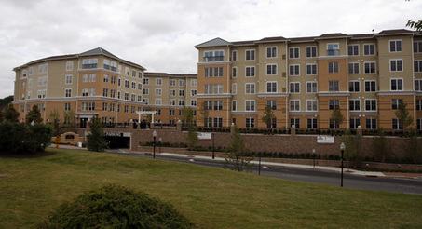
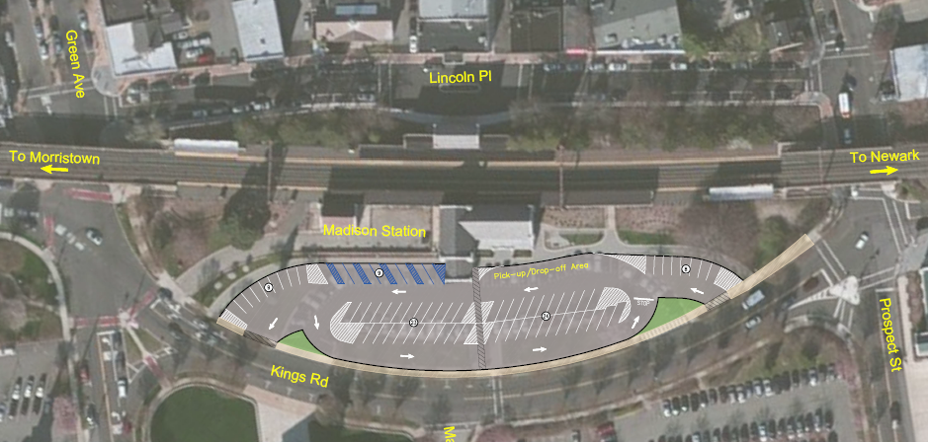
Parking Recommendations
Add parking, improve mapping, add
Kiss & Ride

Slide 13
Summary of Needs: Roadway Access/Mobility
Intersection operation and capacity impedes mobility
  Signal timing
  Lane designation
  Pedestrian interaction
  Signage
  Intersection control devices
Mobility issues related to offsetting street intersections, and delays due to vehicles maneuvering to park in on-street spaces cannot be mitigated without significant impact

Slide 14
Roadway Access/Mobility Recommendations
Re-time signals and implement signal coordination
Actuate some turning movements at intersections
Re-stripe key intersections to add turn lanes
Consider stop sign control at key uncontrolled intersections
Improve bicycle/pedestrian/auto interface at intersections with striping, signage and signalization
Assess methods to improve sight distance at roadway crossings with rail trestle
Conduct warrant studies at key unsignalized intersections; add signals if warranted
Update signage and striping

Slide 15
Summary of Needs: Bicycle and Pedestrian Access
Gaps exist in the bicycle and pedestrian networks
Some signage and markings are deficient or missing
Inadequate year round and seasonal maintenance
Insufficient lighting in some locations
Existing/future demand for bicycle lockers exceeds capacity
Chatham Borough does not have a Bicycle Master Plan
Lack of bicycle/pedestrian access information at stations
Mid-block crossings occur without crosswalks and safety devices

Slide 16
Bicycle and Pedestrian Recommendations
Infrastructure
Improve/add signage and lane markings
Install lighting fixtures
Install pedestrian ramps and signals at intersections
Add mid-block crosswalks and new intersection crosswalks with safety equipment/signage
Expand/connect pedestrian network with new sidewalks
Consider expansion of Traction Line Trail to Madison
Add bicycle wheel channels at stairways

Slide 17
Bicycle and Pedestrian Recommendations, Cont.
Network Management
Designate bicycle routes in Chatham/develop Bicycle Master Plan
Implement Morris County Bicycle Map; connect routes across municipalities
Monitor usage and add bicycle lockers and racks when needed
Improve maintenance of bicycle and pedestrian infrastructure
Develop/post bicycle & pedestrian access information at stations
Consider implementation of bicycle repair/rental shops at stations
Offer preferred auto parking to bike locker patrons

Slide 18
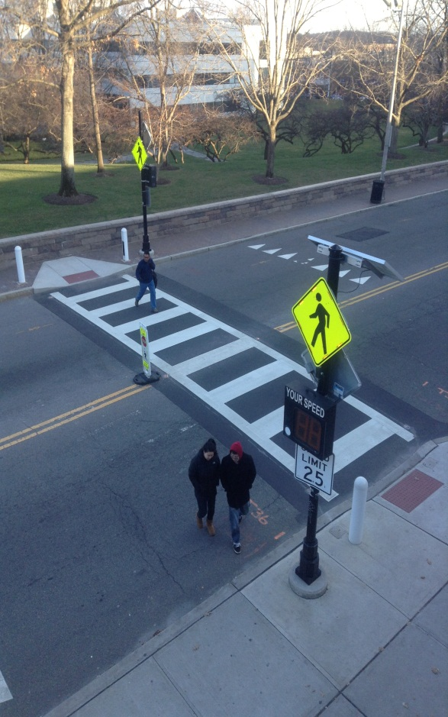
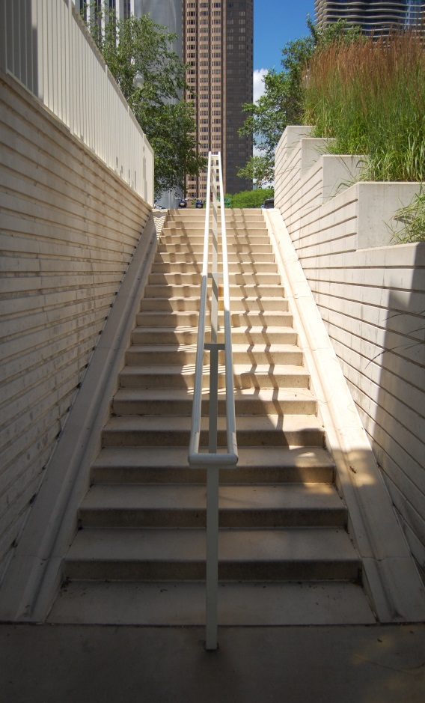
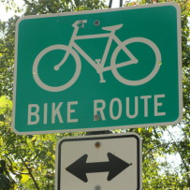
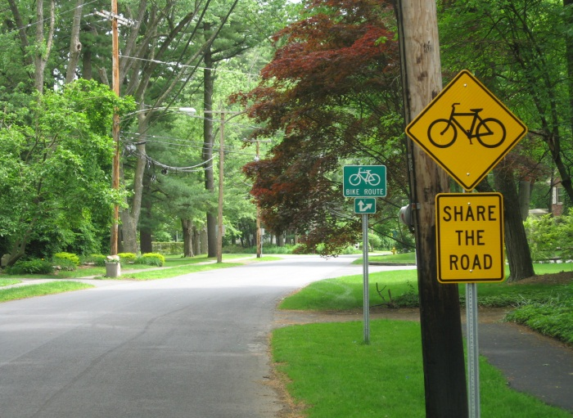
Bicycle and Pedestrian Recommendations, Cont.
Mid-block crosswalks, bicycle wheel channels, wayfinding and safety signage

Slide 19
Summary of Needs: Transit Access
Existing feeder bus to EB rail service (AM) is very limited
Majority of study area has no transit access option
Fare zone structure encourages preference for Chatham Station
Limited station building hours and platform infrastructure discourages transit use and handicapped access
Risky pedestrian activity at Convent Station grade crossing
Transit information sharing/incentives need improvement
  On municipal/county websites
  At area institutions and businesses
  On platform and platform access points

Slide 20
Transit Access Recommendations
Study, sustainably fund and implement feeder bus routes with combined rail ticketing
Consider extending station building hours and adding street-level real-time train information
Develop transit information on homepage of county and municipal websites
Create transit information packets for businesses/institutions; conduct education forums in coordination with NJ TRANSIT

Slide 21
Transit Access Recommendations, cont.
Encourage NJ TRANSIT to study consolidation of fare zones in the study area to improve equalization of access demand amongst stations
Encourage NJ TRANSIT to reconsider free student pass for one week/year or semester
Conduct Operation Lifesaver forums and consider other safety improvements at Convent Station

Slide 22
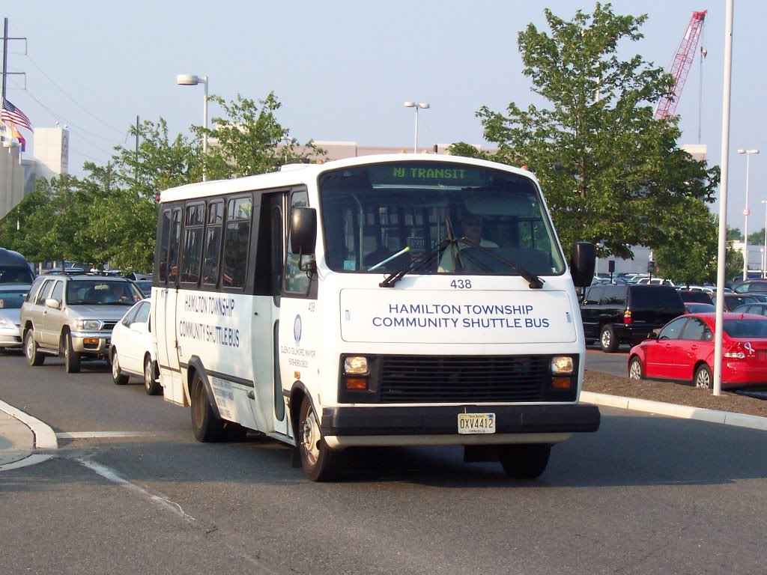
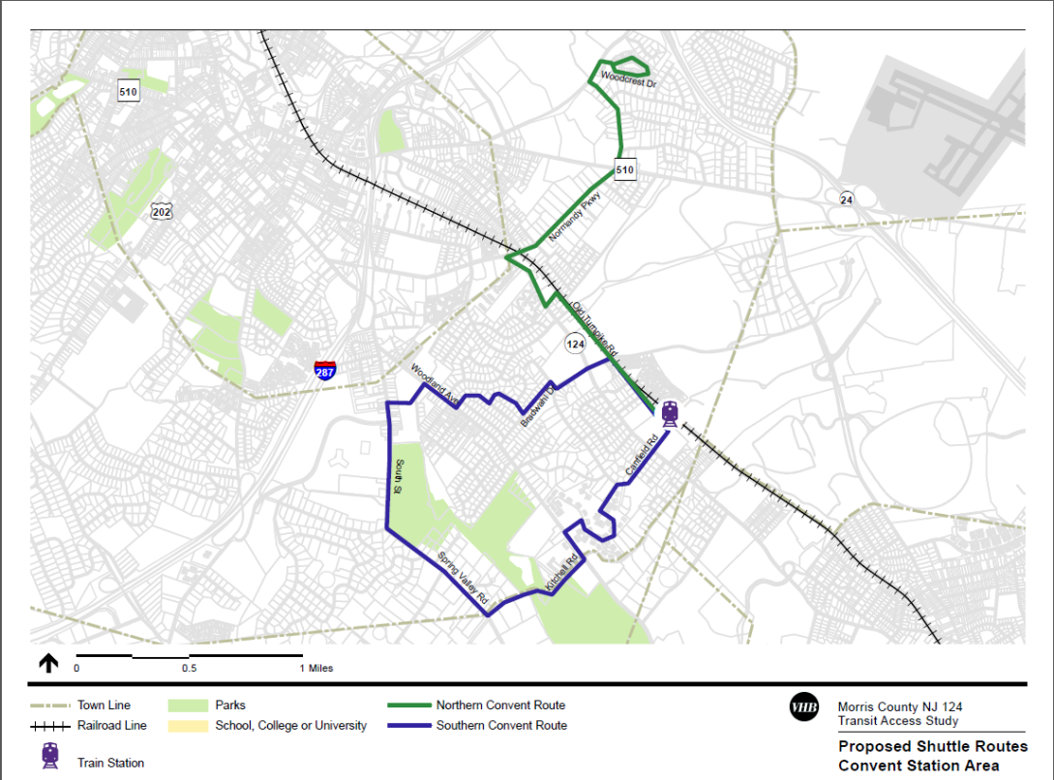
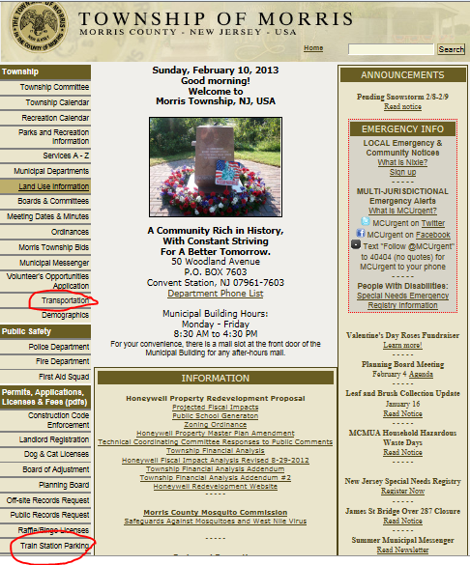
Transit Access Recommendations
Community shuttle buses, potential
shuttle routes at Convent Station,
transportation information

Slide 23
Summary of Needs: Land Use
Chatham and Madison station do not have the traditional TOD housing/employment densities to support their TOD character
Properties are not developed to their maximum land value indicating potential for “spot” redevelopment in a TOD manner
Zoning does not support TOD density that would attract developers
Most “valuable” property at station areas is surface parking
Convent Station offers the most land for development but Madison redevelopment could be more attractive to developers
Apartment and condominium housing for growing young and senior age groups is needed

Slide 24
Land Use Scenario Analysis
Conducted hypothetical analyses of TOD in the three station areas---existing parking parcels and/or adjacent properties were included
Focus was to determine if these areas could attract development with and without the requirement to include commuter parking
Development density and uses were varied to approach a target rate of return on investment
Detailed market analyses and land valuations were not included

Slide 25
Land Use Analysis Results
Convent Station TOD had best rate of return of the “without” commuter parking scenarios (50 du/acre)
Madison Station TOD had the best rate of return of the “with” commuter parking scenarios (50 du/acre)
No definitive best location
No scenario produced the target rate of return (8%) indicating that some incentives would be required
Zoning (density) changes would be required
Development would range from 4-6 stories in height; parking would range from 3-9 stories
TOD resulted in improved taxable values

Slide 26
Land Use Recommendations
Consider TOD redevelopment of properties in vicinity of rail stations
  Supports growth and meets housing needs
  Maximizes land value
  Increases transit usage
  Potentially decreases access by auto
Consider transportation impacts (including parking needed during construction) before proceeding with increased parking and development
Revise zoning to accommodate TOD at selected properties
Encourage zoning and incentives that support developer-provided commuter parking

Slide 27
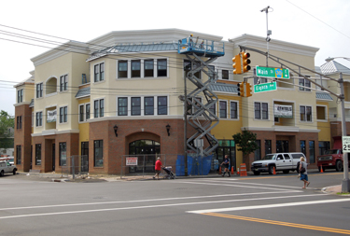
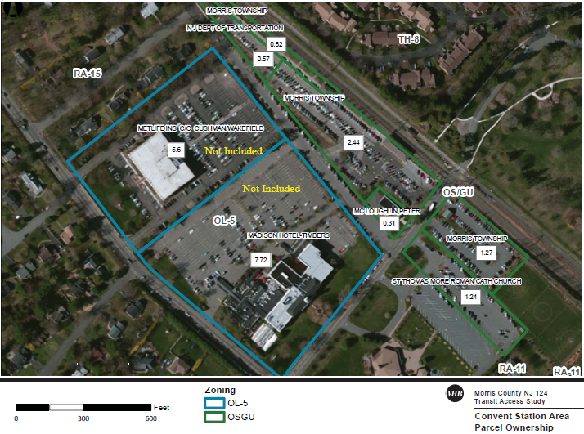
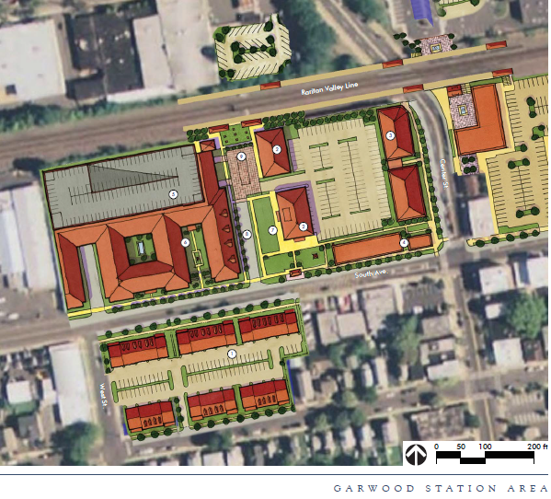
Land Use Recommendations
Seacoast Commons Transit Village in Belmar, Garwood TOD plan, Convent Station parcels considered

Slide 28
Implementation and Funding
Implementation requires a partnership with:
  Neighbor municipalities
  County
  NJDOT
  NJ TRANSIT
  TransOptions
  NJTPA
Public funding for parking expansion is not available; private funding is encouraged through development
Public funding for shuttles is limited
Consider operating costs
  Shuttles
  Parking Facilities

Slide 29
Implementation and Funding
Consider phased implementation
  Start with small improvements such as sidewalk connections, traffic signal re-timings, roadway striping, signage and information
  Initiate studies for large improvements such as transit shuttles, bicycle master plans, parking garages, TOD
  Investigate federal, state and local funding and pool resources and applications: coordinated municipalities get attention!
  Don’t wait until parking problems become extreme; now is the time for action

