Slide 1

FY 2026 CDBG, HOME, and ESG Application
Office Hours
January 29, 2026,
February 6, 2026, and February 10, 2026

Slide 2
AGENDA
Welcome and Introductions
Discuss CDBG and ESG Basics
Application Process
Compliance Requirements
Next Steps

Slide 3
FY 2026 schedule
Applications on County’s website- January 21, 2026
Applications DUE March 3, 2026 by 4:00 p.m.
March 2026 ESG Presentations
April 2026- Project Selection
April 2026 2nd Public Hearing
March 17-19 CDBG & HOME Presentations
Technical Assistance provided to Applicants

Slide 4
2026 funding estimates
Morris County
CDBG Program: $1,853,121
HOME: $924,268
ESG: $166,808
Funding is estimated based upon the 2025 allocations received. Final project budgets will be adjusted after HUD provides the final award amounts for these programs.

Slide 5
CDBG PROGRAM BASICS

Slide 6
Basic CDBG eligible activities
Housing Rehabilitation
Homeownership Assistance
Public Facilities and Improvements
Blight Removal Demolition/Site Preparation
Code Enforcement
Economic Development
Acquisition / Disposition of Real Property
Public Services

Slide 7
CDBG PROGRAM BASICS
Administered by the US Department of Housing and Urban Development.
Cities, states and some counties are eligible to receive funds from HUD.
CDBG GOALS
Provide decent, safe and sanitary housing.
Provide a suitable living environment.
Expand economic opportunities.

Slide 8
CDBG National Objective Requirements
MEETING A CDBG NATIONAL OBJECTIVE…
Provide benefits to low-and moderate-income persons.
Prevent or eliminate slum and blight.
Meet an urgent need that threatens the health and welfare of residents.
CDBG PROGRAM ELIGIBILITY vs INELIGIBILITY… WHO IS ELIGIBLE FOR FUNDING?
Municipalities
Private non-profits that are corporations, associations, agencies or with non-profit status under the Internal Revenue Code 501 (c) 3.

Slide 9
CDBG PROGRAM BASICS
WHAT IS AN ELIGIBLE ACTIVITY?
Serve low- to moderate-income households and individuals
Address slum and blight
QUALIFYING AN ELIGIBLE ACTIVITY – National Objectives
Low-mod income is qualified in three ways:
Area benefit: Service area for a public improvement or facility – Morris County exception limit from HUD is 33.30%, effective with most recent update provided by HUD in 2024.
Income intake: Programs that serve primarily low-and moderate-income individuals and families will be eligible for funding. The definition of a moderate-income family is no more than 80% percent of the area median income, adjusted for household size.
Presumed benefit: Program exclusively serves clients presumed to be principally low and moderate income, including abused children, battered spouses, elderly persons, meet Census Bureau Population Report definition of “severely disabled”, homeless persons, illiterate adults, persons living with AIDS, and migrant farm workers.

Slide 10
Qualifying cdbg areas-
MAPS have updated
WHAT AREAS ARE CONSIDERED CDBG ELIGIBLE FOR MORRIS COUNTY?
KEY CRITERIA FOR AREA BENEFIT
Defined Geographic Area- The project must be available to all residents in a particular area, where at least 33.30% of residents are low- and moderate-income persons. The applicant must clearly define the service area where residents are expected to benefit a public improvement or facility. Morris County is an exception grantee according to HUD’s methodology.
The defined service area is at or above the exception criteria threshold of 33.30% LMI. The 2020 Census Map boundaries must be used to establish the Census Tracts and Block Groups to be used to calculate the LMI percentage.
Updated LMISD Data: HUD updated the LMISD data in 2024 to align with the 2016-2020 ACS 5-Year Estimates.
Links to the HUD LMISD Mapping Tool- Low- and Moderate-Income Area Data- Map Application or the HUD LMI Population by Tract at: LMI Population by Census Tract
The data tables identifying the CT/BG areas which meet the HUD threshold to be CDBG eligible have been added to the Morris County Website.

Slide 11
CDBG Eligible and ineligible costs
WHAT ARE SOME ELIGIBLE COSTS?
Personnel / staff (salary and benefits).
Office / facility rental or lease costs.
Materials and supplies.
Communications.
WHAT ARE SOME INELIGIBLE COSTS?
Fundraising.
Political Activities.
Expenses required to carry out regular responsibilities or functions of local government.
Income Payments.
Building or portion thereof, used for general conduct of government.
Purchase of equipment, fixtures, motors, vehicles, furnishings or other personal property.

Slide 12
ESG PROGRAM BASICS

Slide 13
ESG PROGRAM BASICS
ESG is a federal block grant program that funds services for individuals and families experiencing homelessness or in imminent risk of becoming homeless.
Homelessness Prevention (HP): preventing people at risk from experiencing homelessness
Street Outreach (SO): reaching out to people experiencing unsheltered homelessness
Emergency Shelter (ES): running a low-barrier shelter for people experiencing homelessness
Rapid Re-Housing (RRH): permanent housing assistance for people experiencing homelessness
HMIS: contributing data to the local Homeless Management Information System database
Notes:
There are 5 eligible activities under the ESG program. We will discuss these in more detail in the coming slides.

Slide 14
ESG Emergency Shelter
ESG can be used for essential services and operations for emergency shelters.
Eligible expenses include:
Immediate, temporary shelter for people experiencing homelessness
  Essential services including case management
  Shelter operations (repairs, rent, security, fuel, equipment, furnishings, etc.)
  Renovation costs, including major rehabilitation and conversion.
    Minimum use period applies if a building is renovated with ESG funds.
  If no other shelter is available: hotel/motel vouchers
Notes:
ESG can be used to provide low-barrier emergency shelter operating costs

Slide 15
ESG Street Outreach
Street Outreach activities are designed to meet the immediate needs of unsheltered homeless population by connecting them with emergency shelter, housing, and/or critical health services.
Eligible activities for street outreach include:
Engagement;
Case Management;
Emergency Health Services;
Transportation; and
Services for Special Populations.

Slide 16
ESG Homeless Prevention
J{
Housing relocation and stabilization services and short-and/or medium-term rental assistance as necessary to prevent the individual or family from moving into homelessness.
Activities to prevent people at imminent risk from experiencing homelessness.
  Housing relocation
  Housing stabilization
  Rental assistance
    cannot exceed 24 months during any 3-year period
  Case management
  Imminent risk = housing will be lost within 14 days
  Income restriction- Household is at or below 30% AMI

Slide 17
ESG Rapid re-housing
RRH
Housing relocation and stabilization services to help homeless individuals and families quickly achieve housing stability and maintain permanent housing.
Permanent housing for people experiencing literal homelessness or fleeing domestic violence
  Housing relocation
  Housing stabilization
  Rental assistance
    Cannot exceed 24 months during any 3-year period.
    Tenant based or project based
    Must have a legally binding lease
  Case management
  Homelessness at time of receiving

Slide 18
Homeless management information system (HMIS)
Subrecipients of ESG Grant Awards are required to participate in the CoC and use the approved HMIS system.
Eligible HMIS activities include:
  HMIS data entry and reporting;
  Attending HMIS Training;
  Computer Hardware; and
  Software related to HMIS.

Slide 19
Program Matching Requirements
CDBG- No Match requirements
HOME- 25% Match required
ESG- 100% Match required
Match funds must be used for activities that are eligible under the grant contract, can be cash or in-kind.

Slide 20
HOME Program Basics

Slide 21
HOME investment partnership Program
Housing Programs – provide safe and decent housing for low- and moderate-income households.
Rental Housing
Owner-Occupied Housing
Homebuyer Assistance
Rehabilitation
New Construction
Tenant Based Rental Assistance (TBRA)

Slide 22
HOME Investment partnership program
HOME investment partnership Program
For-Profit Developers
Non-profit developers

Slide 23
HOME investment partnership Program
CHDO – Community Housing Development Organization
Community-based
Focus on Housing
Board composition with community representation
Notes:
15% of the HOME grant is set aside for CHDOs

Slide 24
Application process

Slide 25
Things to remember
Applications are Due March 3, 2026, by 4:00PM
One application per program
One application per Municipality
2 or fewer open activities under existing contract to Apply
Submit one paper copy, unstapled
Please tell us your intent to submit
CDBG funds can not serve Dover, Parsippany-Troy Hills

Slide 26
It is important to think about
Do you have the institutional capacity?
Is the Activity financially viable?
Are all sources of funding committed?
Do you have the match requirements?
Know the CDBG/HOME rent and income guidelines
Can the project be completed with one grant?

Slide 27
Does your application
Comply with the 5 Year Consolidated Plan
Satisfy 1 of the 3 National Objectives:
Benefit Low- and Moderate-Income People
Serve to eliminate Slum and Blight
Meet an Urgent Need
Meet an Identified Priority
Is it eligible

Slide 28
Does your application
Comply with the 5 Year Consolidated Plan
Satisfy 1 of the 3 National Objectives:
Benefit Low-and- Moderate Income Persons
Serve to eliminate Slum and Blight
Meet an Urgent Need
Meet an Identified Priority
Is it eligible

Slide 29
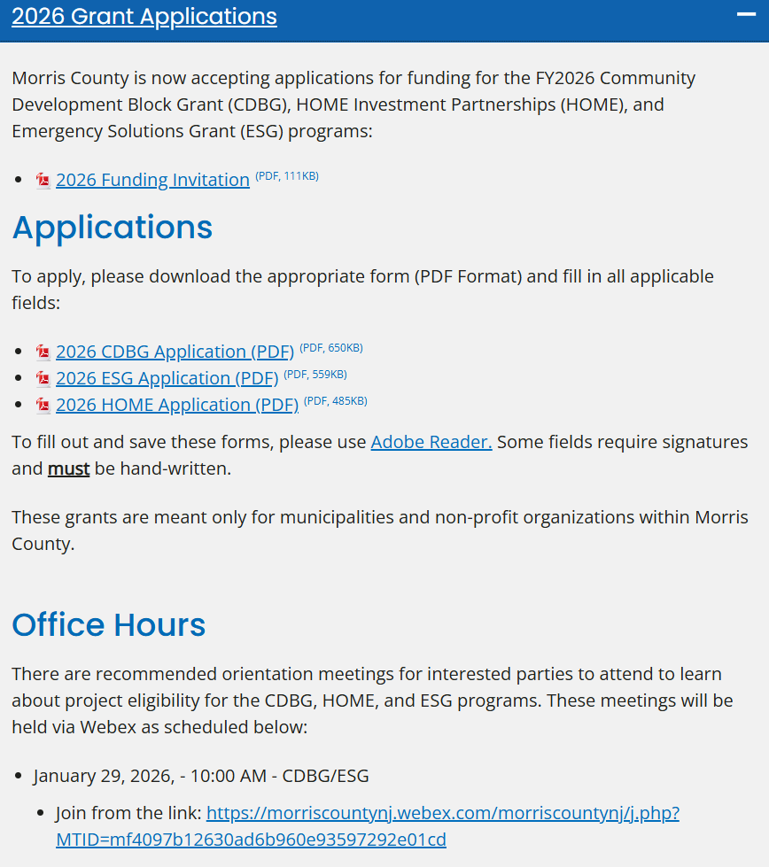
Navigating the website https://www.morriscountynj.gov/Departments/Community-Development

Slide 30

Community Development Revenue Sharing Advisory Committee (CDRS)
A group of representatives from 37 municipalities
Two County Commissioner appointees
Make up 4 Subcommittees
  Housing
  Facilities
  Improvements
  Services
Regional Coordinators– 7 Members, from each region, make up the Executive Subcommittee

Slide 31
facilities
housing
improvements
services
Regional coordinators
Full CDRS
Board of County Commissioners
US Department of Housing and Urban Development

Slide 32
Presentation strategies

Slide 33
Presenting your application
Show up
Be confident
Impressions matter
Be knowledgeable about the proposal
Offer credible supporting information
Please let us know if you will be using PowerPoint

Slide 34
NEXT STEPS
Public Hearing on 2026 AAP being held on February 10, 2026, at 5:30 p.m.
Approval of Plan by Morris County Board of Commissioners
Drafting 2026 Annual Action Plan
CDRS Presentations & Selection of Projects
Submission of 2026 AAP to HUD
Applications due by March 3, 2026, by 4:00 p.m.
Morris County will contact successful applicants after HUD approval

Slide 35
After being awarded the grant
Environmental Review
HUD Authorization to Use Funds
Grant Agreements
Compliance Package

Slide 36
Federal Labor standards Compliance
Davis-Bacon and Other Labor Standards Compliance:
Required for any CDBG funded facility or infrastructure improvement project funded with $2,000 or more in federal funds, and housing rehabilitation projects with 8 or more units.
Required for HOME funded projects that construct or rehabilitate 12 or more HOME assisted units.
CDBG and HOME funded projects that do not meet the threshold requirements will defer to the NJ Prevailing Wage Act for wage compliance requirements.
Morris County will oversee and monitor the projects for compliance with federal labor standards and will provide training and technical assistance to successful applicants after award of funding. For applicable projects, there will be additional monitoring and reporting, including weekly certified payroll, contractor employee interviews, and reporting to HUD on any wage restitution as required.

Slide 37
Section 3 Compliance
Construction projects where the total amount of HUD-assisted funds exceeds $200,000 must comply with the Section 3 requirements as defined in 24 CFR Part 75, which targets economic opportunities of HUD funded projects to low- and moderate-income workers.
  Records must be maintained and provided showing labor hours worked by Section 3 and Targeted Section 3 workers as well as total labor hours worked by all workers.
  Goals- 25% of all work hours on construction is performed by Section 3 workers, with 5% of that amount performed by Targeted Section 3 workers.

Slide 38
BABAA Compliance
Construction projects where the total project cost exceeds the simplified acquisition threshold of $250,000 will be required to document compliance with the Build America, Buy America Act (BABAA) signed into law in November 2021.
HUD currently has general waivers in place, which sets the $250,000 threshold for compliance, through November 2027. Compliance requirements could change in the future based upon continuation of these waivers.
Subrecipients awarded funds will be required to include the BABAA provisions and compliance requirements in the procurement process for applicable projects, with additional reporting to Morris County that documents compliance by the contractor.

Slide 39
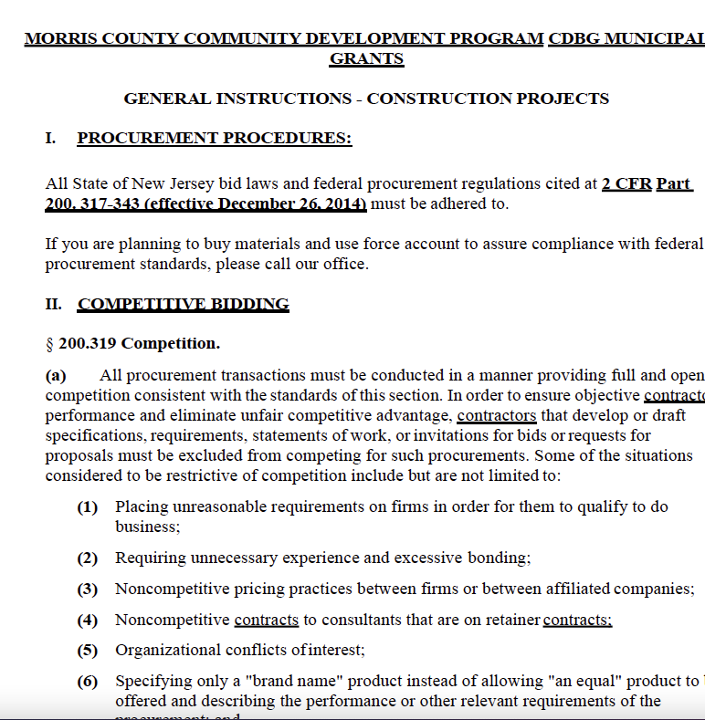
Compliance package
Compliance Package
Bid Process
Debarred List
Contract
Davis Bacon Wages
Reporting
BABAA Compliance
Bid Process
Debarred List
Contract
Davis Bacon Wages
Reporting

Slide 40
Timeliness
CDBG, HOME, and ESG funds must be spent in a timely manner to avoid recapture or reduction in future funding for Morris County. Funds awarded must be spent within the following timeframes.
12 months for CBDG
4 years for HOME
24 months for ESG

Slide 41
QUESTIONS

Slide 42
Final words
The PowerPoint Presentation will be shared with those in attendance; Please add your name and email address in the chat.
Please use this link provided to access this PowerPoint Presentation. (Once Posted on County of Morris website)
https://www.morriscountynj.gov/Departments/Community-Development

Slide 43
For further Information, please contact:
Rajini Hodigere
Morris County Department of Human Services
Community Development
(973) 285-6060
rhodigere@co.morris.nj.us
Or
Lauren Van Horne
Morris County Department of Human Services
Community Development
(973) 285-6033
Lvanhorne@co.morris.nj.us

