Slide 1
Code Blue Reporting Overview
Presented by:
Maria Fodali, Office of Temporary assistance
Wesley Gaynor and Kamille Freitas, Homeless Solutions Inc.

Slide 2
Code Blue Changes
Code Blue Providers Workgroup expansion
Preparation
Outreach
Conferencing
Reporting and the Reporting Workgroup
Emergency shelter options
Notes:
Flyers and additional resources with Spanish translation (flyers – 3 sets, resource guide, cards, wider dissemination) (always procedures and resource guides annually)
Bi-weekly meetings
Reporting
Working on adding to county webpage
Workgroup created
More qualitative analysis – client/consumer & provider surveying (restructuring open forum event)

Slide 3
Code Blue Declarations
2021-2022 Code Blue Season
9% increase in declarations compared to 2020-2021 Code Blue Season
Trending upwards since 2019
2022-2023 Code Blue Season (in progress)
91 declarations as of 3/15/23
Notes:
105 activations Nov 2021-March 2022
96 2020-2021
76 2019-2020

Slide 4
Cumulative Warming Center Operations
Less Warming Center options during 2021-2022 Code Blue Season compared to previous years
Homeless Solutions Warming Center non-operational due to construction enhancements for guests (movable room divider, showers, laundry room, and lockers)
Continued discontinuation of Morristown Fire House and Dover Warming Center (St. John’s)

Slide 5
Homeless Solutions Overnight Center: Spring 2022 Pilot
May 1, 2022 – September 3, 2022
Expansion in bed capacity and amenities translated into increased services
Statistics
Increase in bed capacity from 12 beds in 2020-2021 to 14 beds in 2022 for pilot program
73 unduplicated participants, 10.6% increase from 2020-2021 Code Blue Season
18 guests/participants were transition into a Homeless Solutions Shelter Program, which is a 157% increase from 2020-2021 Code Blue Season
1,399 bed nights, a 21% increase from the 2020-2021 Code Blue Season
2,789 meals, a 17% increase from the 2020-2021 Code Blue Season

Slide 6
Office of Temporary Assistance (OTA)
Motel placements are supplemental to emergency shelter/warming center availability
Market Street Mission and OTA Motel placements were sole emergency shelter options during 2021-2022 Code Blue Season
Continued use of out of county motel placements
2021-2022 Code Blue Season had a 347% increase in nights of shelter provided and 214% increase in households served when compared to the 2020-2021 Season
Utilization of motel placements for Code Blue continues to increase exponentially year-to-year
Factors at play: Higher guest vulnerabilities, less warming center options and capacity, shelter capacity changes, COVID-19 non-congregate shift
2022-2023 Code Blue Season in progress – currently trending high
Notes:
2020-2021
CB declared nights of shelter: 893 , 70 households
All CB season placements 5,629
2020-2021 Code Blue Season had a 26% increase in households served and a 74% increase in nights of shelter provided when compared to the 2019-2020 Code Blue Season
2021-2022
CB declared nights of shelter: 3,096, 150 households
All CB season placements: 13,617

Slide 7
Code Blue Outreach and Additional Services
Family Promise of Morris County
350 Code Blue referrals for placement made during the 2021-2022 season
Nourish NJ
Outreach and meal supports
Market Street Mission (MSM)
61 guests served with emergency shelter in the 2021-2022 season
Guests also received meals, information about other MSM programs, and could attend Chapel services

Slide 8
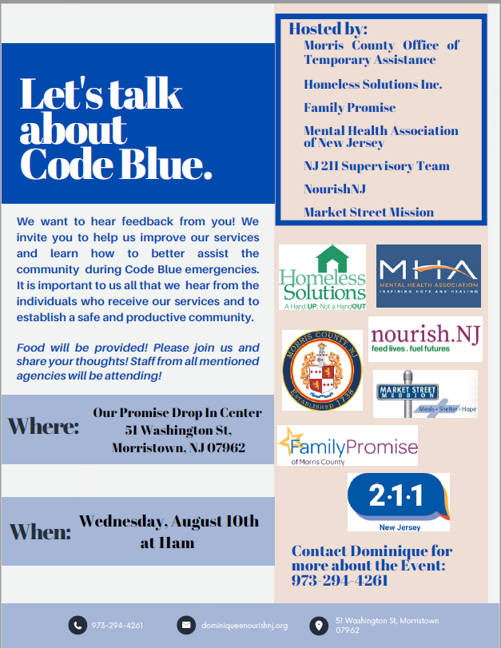
Qualitative Code Blue Analysis
Code Blue Providers Survey for 2021-2022 Season
Disseminated via email through the Community Assistance Services (CAS) and Office of Emergency Management (OEM) distribution groups
Topics covered:
Provision of Code Blue Services
Code Blue Procedural Knowledge
Code Blue Accessibility of Services
Long-Term Planning/Improvements for Code Blue
COVID-19 Implications
Municipalities
Code Blue Open Forum Event for 2021-2022 Season – client-centered
1-day event for consumer feedback on Code Blue services
Opportunity to connect directly with providers in a casual, unstructured format
Topics covered:
Navigation of Code Blue Services
Code Blue Accessibility of Services
Safety and Support re. Code Blue Services
COVID-19 Implications
Barriers in the Code Blue System

Slide 9
Code Blue Providers Survey 2021-2022 Season
27% increase in responses for 2021-2022 survey
0% response rate from townships and police departments – targeted area for future feedback
Steady increase since survey inception in 2019 in overall response rate
Statistical Highlights
11% increase in agencies providing assistance to community residents accessing the Code Blue System (transportation, food, case management, emergency placement, info/referrals)
0% of agencies reported a poor understanding or no understanding of the Code Blue System, overall confidence in agency knowledge of the Code Blue System increased
Overall increase in homeless community and general resident knowledge of the Code Blue System
100% of agencies were able to get answers to Code Blue questions (9% increase from 2020-2021 season)
15% increase in accessibility of Code Blue services, 79% of responding agencies reported improvements in the 2021-2022 season re. accessibility of services
Long-term placements were the highest requested improvement in 2020-2021 vs. lower barrier warming centers in 2021-2022
Feedback given on 2021-2022 services as more coordinated and inclusive
Notes:
In 2020-2021 – 2 townships and 1 pd responded compared to 2021-2021 0 responded → OEM did not push out the same way
36% respondents neutral, disagree re. Accessibility of CB services in 2020-2021 vs 21% respondents neutral or disagree with accessibility of services in 2021-2022
-issues of navigating between OTA/211 and understanding MSM rules/regs were cited
2022-2023 Providers Survey to be disseminated in April 2023

Slide 10
Code Blue Open Forum 2021-2022 Season
Highlights
Clarity needed on various services/programs and rules (messaging needs to be simple and clear)
Satisfaction with community provider guidance and support, well-known activations - “tremendous difference in quality of services”
Phone access is a barrier
Consumers of Code Blue services prefer security presence at placement locations and feel most safe with supervision
Prepared/to-go food options were suggested
Increased day time warming center options needed
Motel placements were preferred for COVID-19 concerns/reasons
Additional mental health supports suggested at the placement locations
Accessibility of afterhours help was cited as an area for improvement
More options for emergency placements and a quicker placement/turnaround time were expressed as needed
Notes:
2022-2023
March 2023 surveying outreach project

Slide 11
Code Blue Seasonal Improvements
Code Blue Providers Committee worked on simplifying messaging and clarifying access points to the system in 2022-2023 Code Blue seasonal outreach
Basic flyers in English and Spanish
Translated Resource Guide
Family Promise developed Code Blue cards
Posted Code Blue declarations at social service agencies
MHA and Navigating Hope conducted on-site Warming Center visits in 2022-2023 season and more amenities were provided through the Homeless Solutions Warming Center (laptop usage, laundry, lockers, showers)
Code Blue Providers all coordinated phone accessibility for afterhours drop-ins and alternative placement needs
Code Blue reviews/announcements/updates and training opportunities for providers and local service agencies
Notes:
2022-2023
March 2023 surveying outreach project

