Slide 1

2026 Morris County Capital Plan
2025 Board of County Commissioners
Tayfun Selen, Commissioner Director
Stephen H. Shaw, Commissioner Deputy Director
Christine Myers, Commissioner
Douglas R. Cabana, Commissioner
John Krickus, Commissioner
Thomas J. Mastrangelo, Commissioner
Deborah Smith, Commissioner
Notes:
Steve

Slide 2
Table of Contents
Capital Budget Committee
Inventory
Standard Investments
Strategic Investments
Infrastructure Investments
Summary Financials
Notes:
Steve

Slide 3
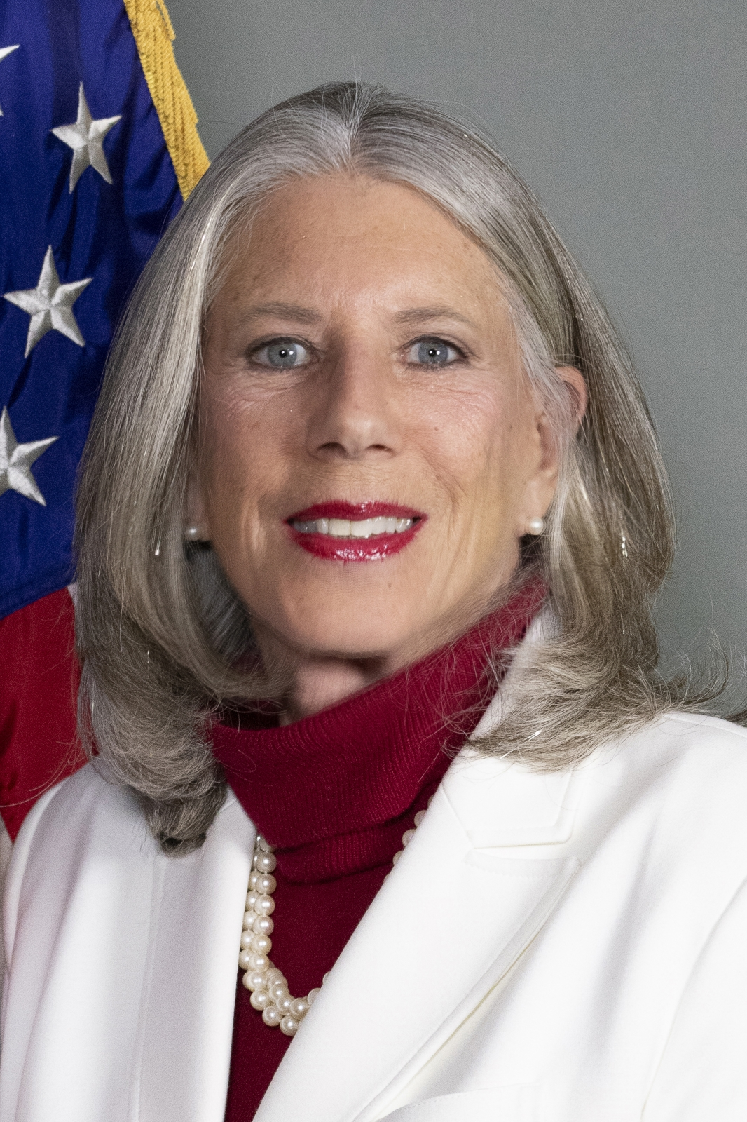
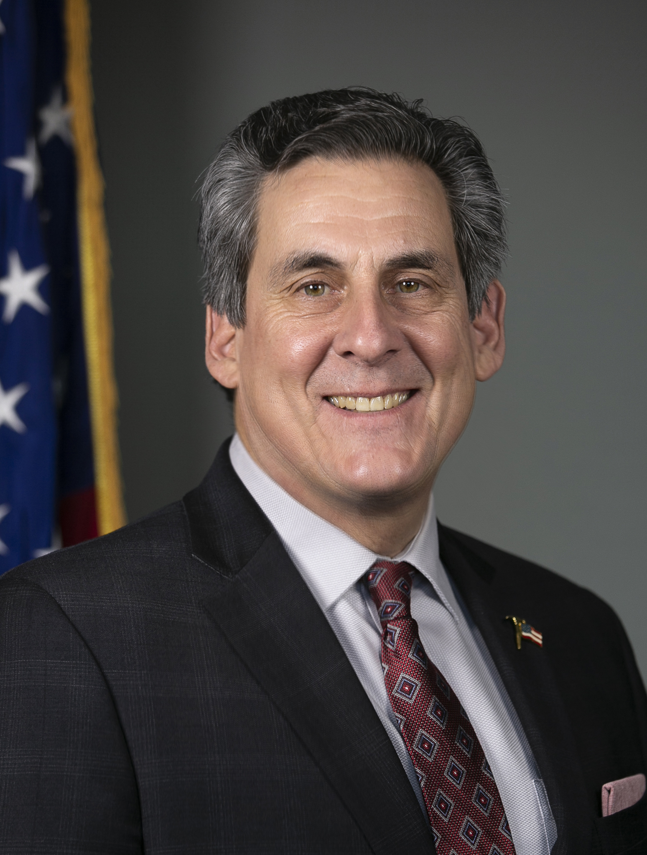
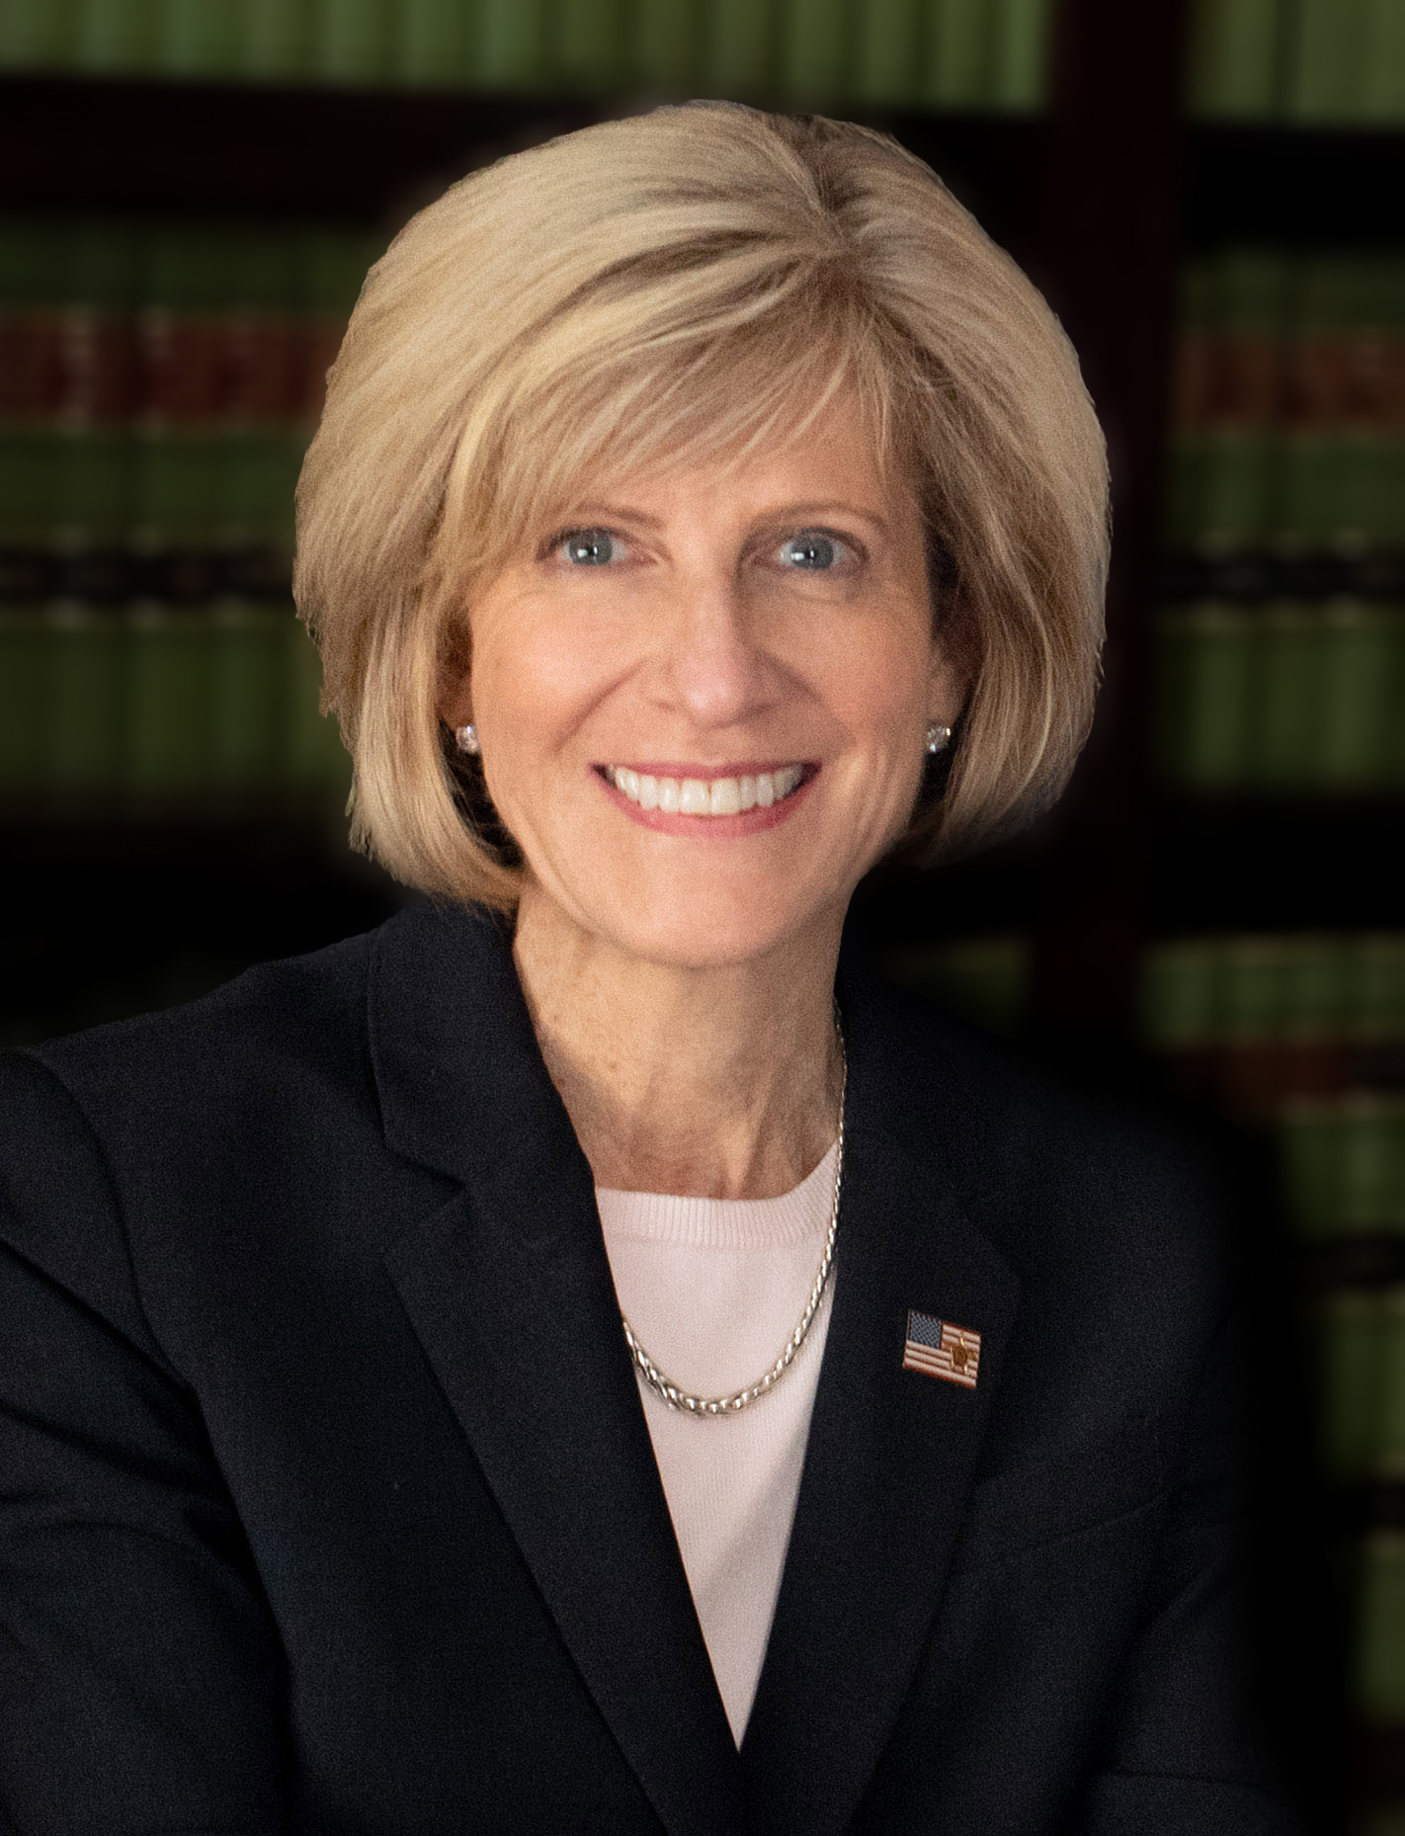
Commissioners who served on the Capital Budget Committee
Deborah Smith Stephen H. Shaw, Chair Christine Myers
Notes:
Steve

Slide 4
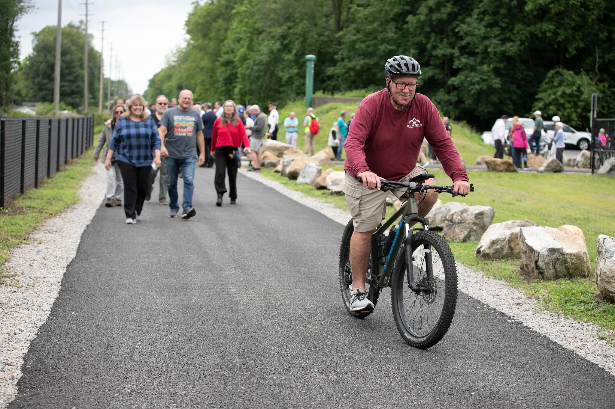
Our inventory of responsibility is massive and diverse.
287 miles of county roads
1,000 bridges and culverts
3 Freight Railroads
1,200 vehicles and pieces of equipment
3.4 million square feet of buildings / structures
Facilities required by the Judiciary, Sheriff, Law and Public Safety
All trees within the County’s road right-of-ways
Mosquito Control services throughout all Morris County
20,611 acres of parkland & 39 recreational facilities
The 5.1-mile Pompton Valley Rail Trail ribbon cutting May 29, 2025.
Notes:
Christine

Slide 5
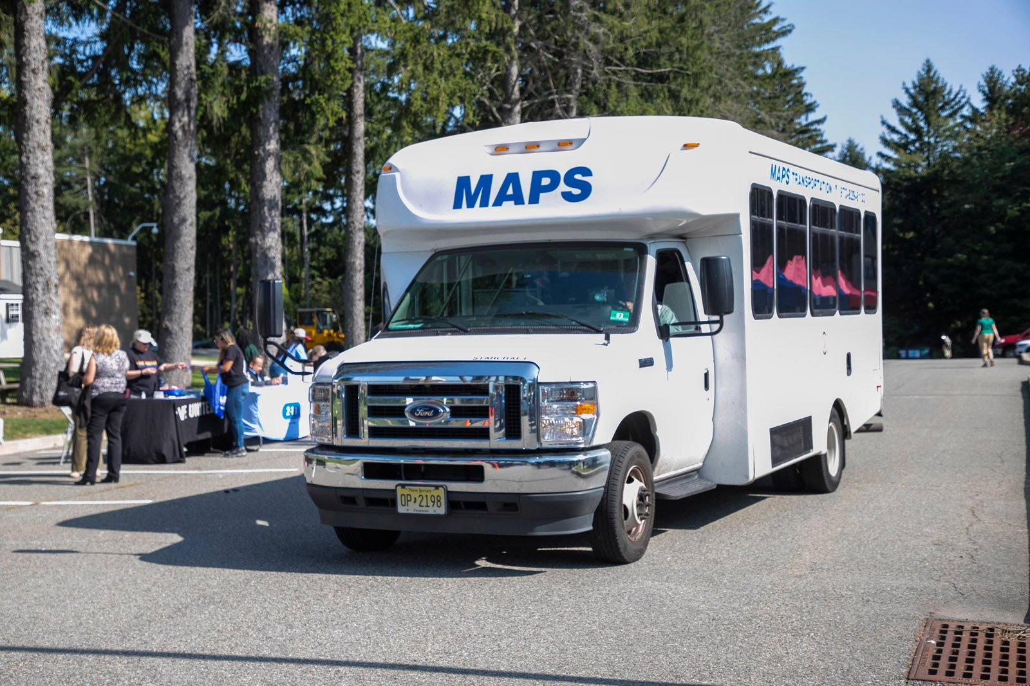
Standard Investments of $13,321,138
Security Upgrades & Sheriff’s Office Equipment
Buildings & Grounds Improvements
Vehicle Replacements
IT Equipment & Services Updates
Morris Area Paratransit service bus.
Notes:
Christine

Slide 6
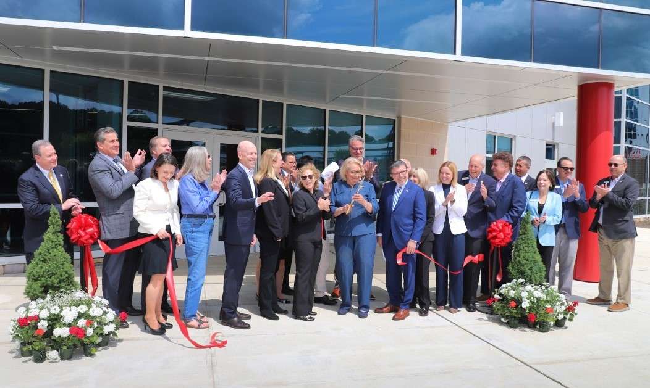
Strategic Investments totaling $6,655,261
Fire Alarm & Sprinkler Upgrades
Emergency Communication System Improvements
Sheriff’s Patrol Building Fit Out
Downtown Parking Facilities Upgrades
Ribbon cutting for Vocational School District Career Training Center on May 30, 2025.
Notes:
Christine

Slide 7
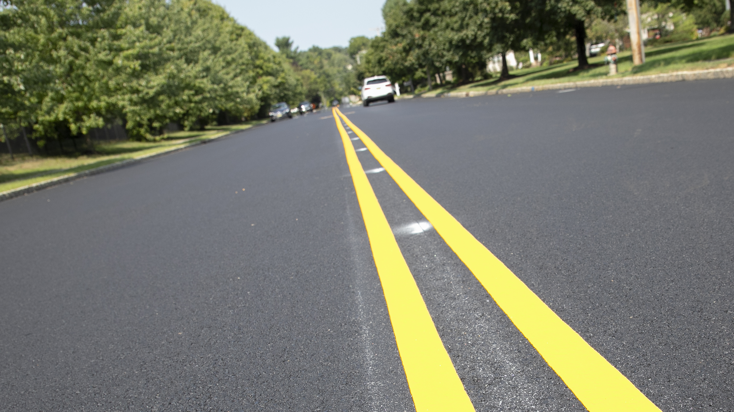
$30,067,500 in Infrastructure Investments
Road Resurfacing
Dam Safety Projects in Parks
Intersection and Road Improvement Projects
Bridge Design and Construction
Drainage Design and Construction
Railroad Rehabilitation and Improvements
Notes:
Deb

Slide 8
A sampling of Resurfacing projects funded in the 2026 Capital Plan
3.6 miles of Fairmount Avenue in Chatham Borough and Chatham Township
1.3 miles of Green Pond Road in Rockaway Township
1.8 miles of Ridgedale Avenue in Florham Park Borough and East Hanover Township
4 miles of West Mill Road in Washington Township
Notes:
Deb

Slide 9
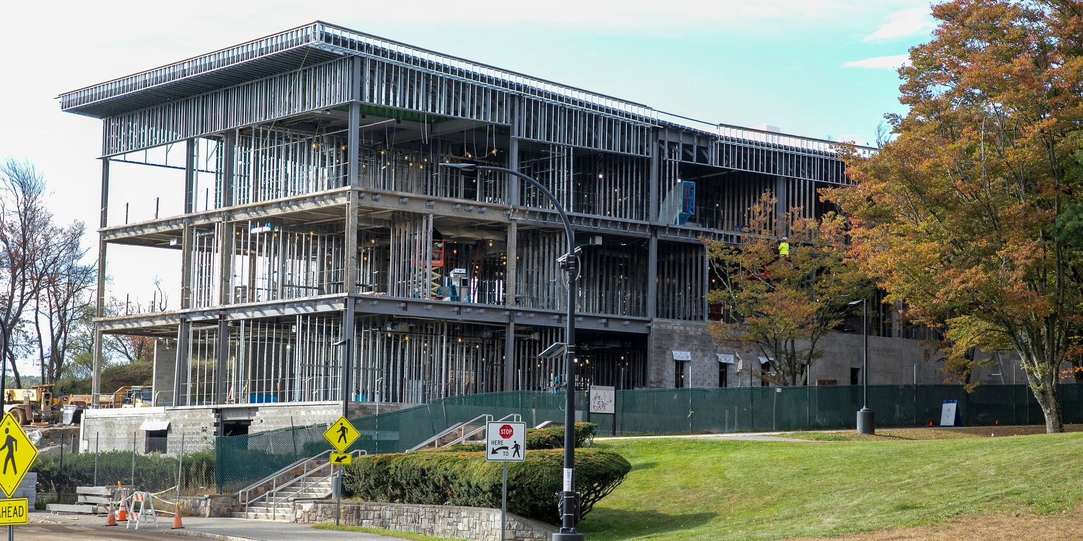
Summary Financials of 2026 Capital Plan
Description | Dollars
2026 Full Capital Plan | $50,043,899
Less Grants | -$13,145,191
Net 2026 Capital Plan | $36,898,708
Construction of the Center for Health Professions at the County College of Morris underway, October 15, 2025.
Notes:
Deb

Slide 10
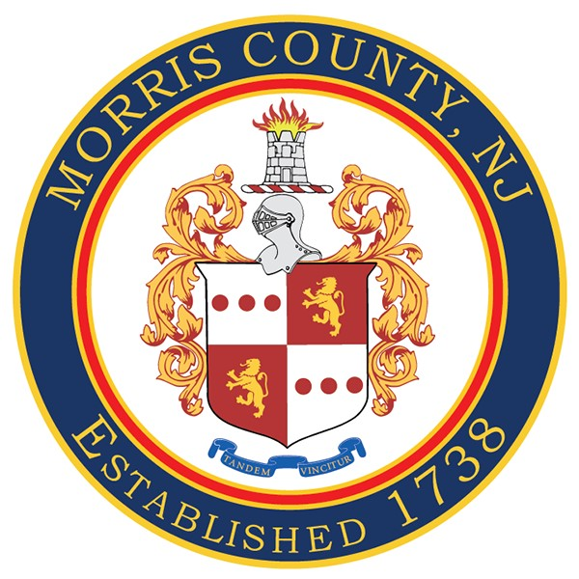
Morris County 2026 Capital Plan
Thank you
Notes:
Steve

